Slide 1

ICEG
REVIEW COMITE
02/10/2025
Location: Zaal 00.08 Seine @BOSA (WTC III, Simon Bolivarlaan 30 Brussel)

Slide 2
Welcome & agenda of the meeting

Slide 3
AGENDA
TOPIC | TIMING
Welcome and agenda | 14u00 – 14u05
Status of the signing of the ICEG Agreement | 14u05 - 14u10
Overview of exercises | 14u10 - 14u20
Update belgif website | 14u20 – 14u30
Short update translation OSLO standards | 14u30 - 14u35
Draft agenda items for ICEG Management committee (16/10/2025) | 14u35 - 14u45
Other topics? | 14u45 - ...

Slide 4
Update ICEG collaboration agreement Review Comité

Slide 5
Update Belgif website Review Comité

Slide 6
Short update translation of OSLO standards Review Comité

Slide 7
Evolution of the collaboration agreement
2023-12-13 ICEG committee: approval budget by 4 parties (FWB and SPW still needed to confirm)
2023-12-13 Confirmation from FWB
2024-02-19 Confirmation from SPW
2024-07-22 Approval IF BOSA – agreement was signed by BOSA
2024-07-24 Minor modifications requested by Flanders
2024-08-12 Approved by Legal BOSA on 2024-08-12
2024-08-01 Message SPW: IF does not approve
2024-11-08 Favorable advice from IF SPW
2024-11-08 ICEG review committee: Modifications requested by IF SPW
–No exclusivity for Flanders to contract external parties to support data standardization exercises
2024-12-11 ICEG review committee: Review of collaboration agreement
2024-12-19 Green light from Legal BOSA + Procurement BOSA
2025-01-20 Deadline for final validation via representatives by each party
2025-01-21 No comments were received
2025-01-28 Submitted & waiting for final approval of IF BOSA
2025-04-15 No update so far
2025-10-01 Last signature of the agreement

Slide 8
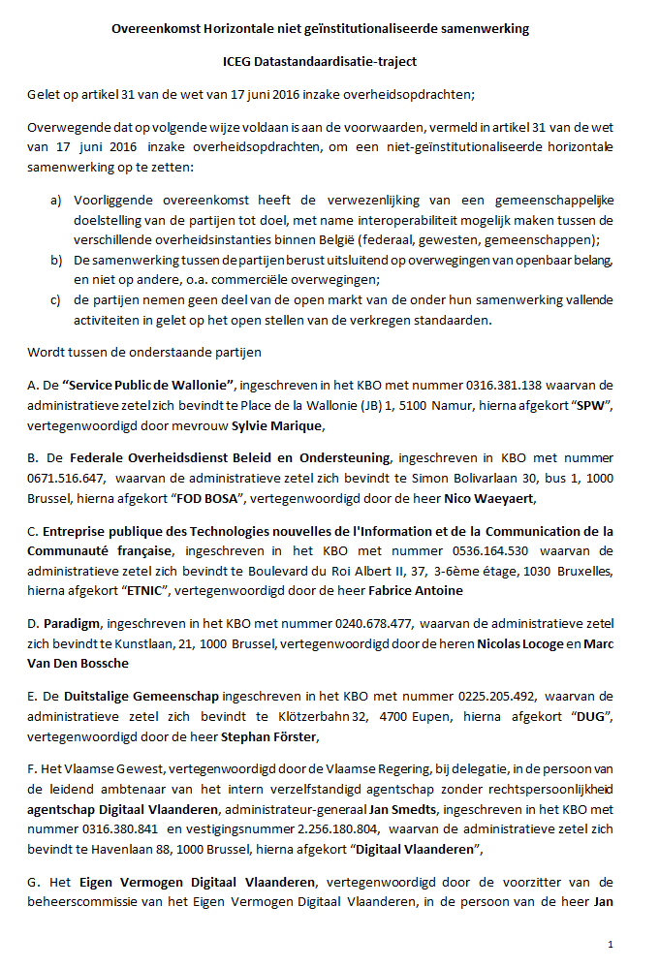
Budget foreseen in collaboration agreement
Contributing Organisation | Approved budget 2024 (€) | Cost allocationKey (%)
BOSA FOD Beleid & Ondersteuning | 80.000 | 27,59
Digitaal Vlaanderen | 80.000 | 27,59
Service Public de Wallonie (SPW) | 50.000 | 17,24
Paradigm (for the Brussels Region) | 20.000 | 6,90
ETNIC (for the Fédération Wallonie-Bruxelles) | 50.000 | 17,24
German speaking community | 10.000 | 3,45
Total | 290.000 | 100,00
Start date: date of signing by all parties for a period of 2 years​
Notes:
"De overeenkomst treedt in werking op de datum van de ondertekening door alle ICEG-partijen (meer bepaald de datum van de laatst geplaatste digitale handtekening)voor de bepaalde duur van 2 jaren."

Slide 9
Topics approved but on hold until signing of collaboration agreement
Topic | Budget (€)
ICEG: Person Start new trajectory | 71.100
ICEG: Hydrants Extra budget for additional semantic issues that need to be addressed by the firefighters and the water companies | 18.170 (20 MD)
Assessment BeST | TBD: 13.000 (10 MD)
Translation of the OSLO standards => DV | 150.000
Total | 252.270

Slide 10
Collaboration agreement: Impact for ICEG Committee
For each interoperability initiative proposed by the ICEG review committee, the ICEG Committee will have to
accept or reject the proposal
free the budget for supporting the proposal
indicate which party of the collaboration agreement can
contract an external party to support the proposal
send invoices to the other parties of the collaboration agreement to split the costs according to the cost allocation keys defined in the collaboration agreement
ratify the result in case of a new data standard

Slide 11
Roadmap Belgif website Eveline Vlassenroot & Bert Van Nuffelen

Slide 12
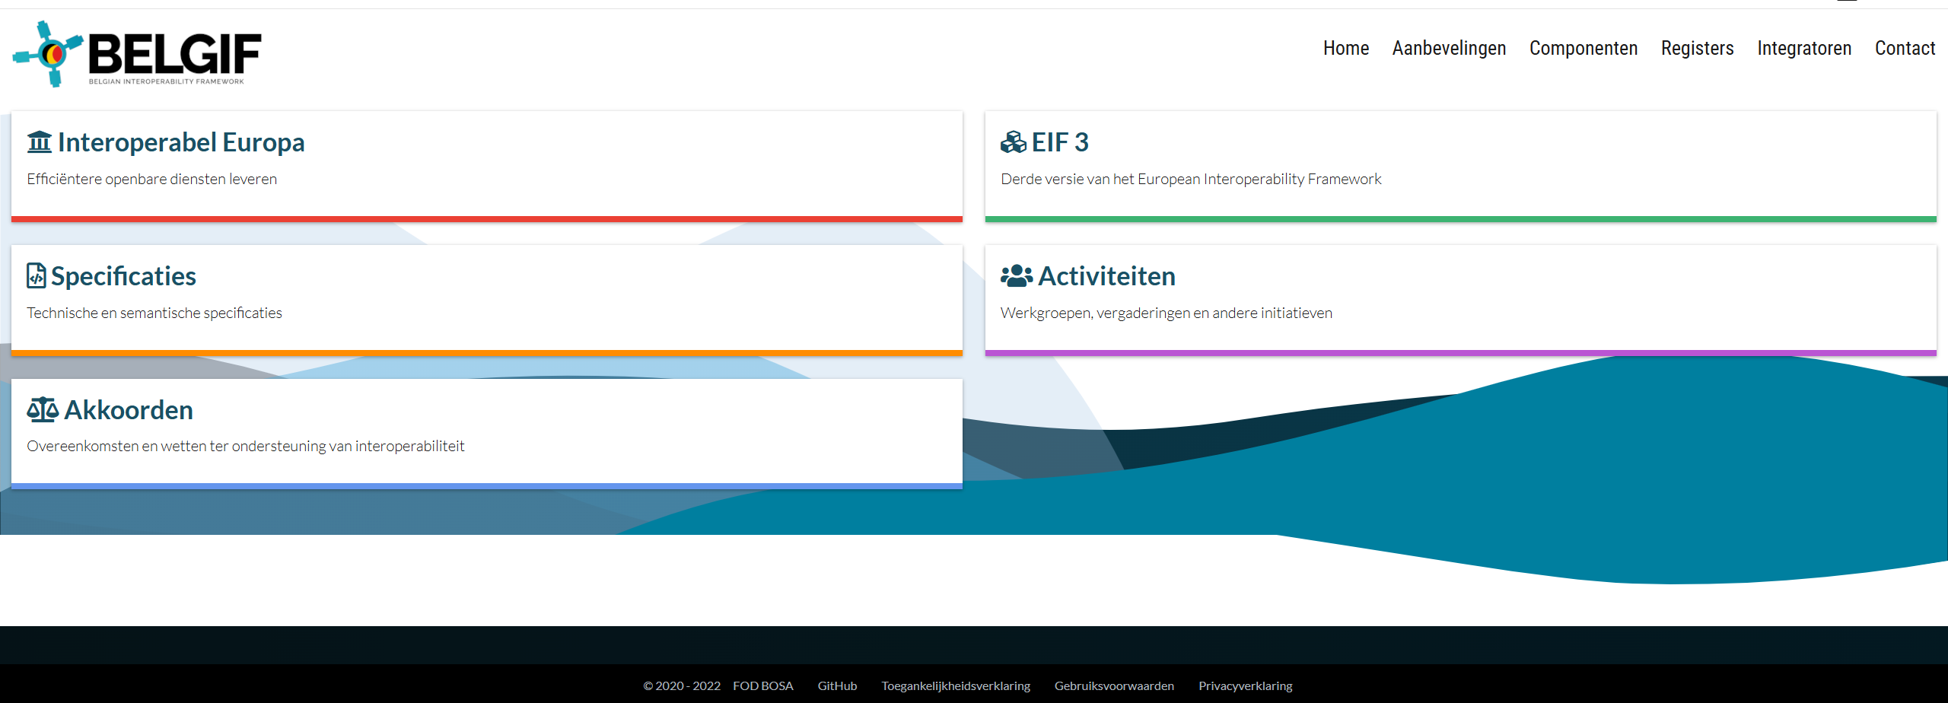
Belgif website

Slide 13
Motivation for update
Questions from stakeholders
Use case IMKL: User experience to find ICEG standards
Translation exercise
Included in the ICEG agreement 2025
Interoperable Europe Act
Publication interoperability solutions

Slide 14
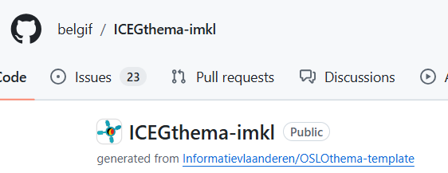
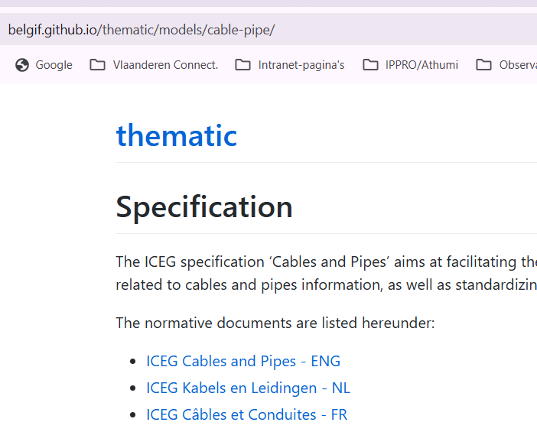
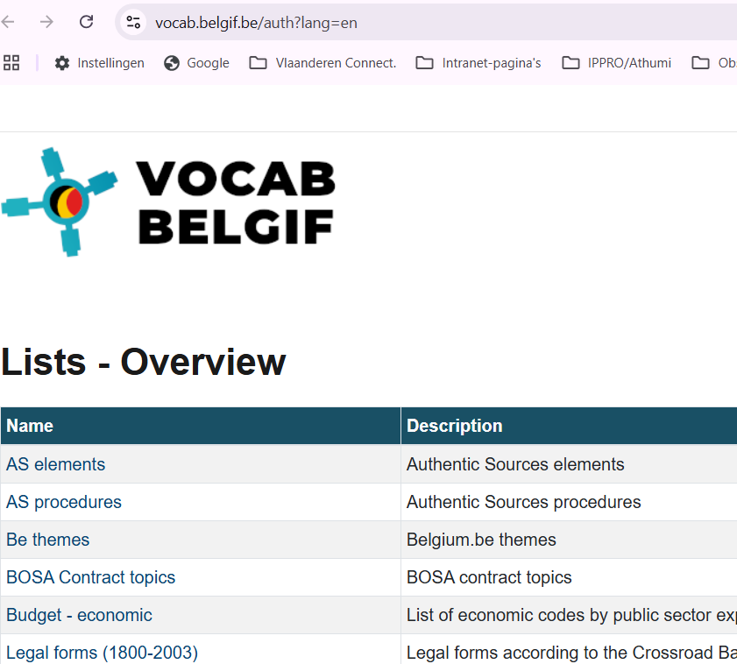
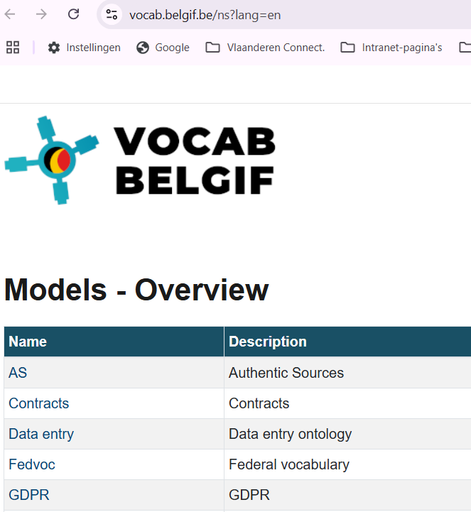
User experience (use case IMKL)
Backend (GitHub)
3 UI’s
Online Specification
(semantic model)
Codelists
(implementation model)
XSD-scheme
(implementation model)

Slide 15
Proposal
Belgif as a landing page for
Communciation about ICEG acitivities
Documentation of the ICEG Review meetings
Discovering the ICEG standards
Discovering Interoperable Europe Solutions
...
Other ideas?

Slide 16
Roadmap: first steps
Publication flow:
Test running 2 dockers (Bart H & Bert VN)
User Experience
Improve portal Belgif to make interoperability solutions (eg. ICEG Data Standards) findable
Set up content workflow

Slide 17
Status ICEG agreement Marc Bruyland

Slide 18
Code Régional de la Donnée Eric Auquiere

Slide 19
Draft agenda items for ICEG Management Comité (16/10/2025) Review Comite

Slide 20
Topics for ICEG Management Meeting 16/10/2025
Status of the ICEG Collaboration Agreement
Who will present these topics?

Slide 21
Other?

Slide 22
Planning
Date | Meeting | Location
27/02/2025 | ICEG Review Comite | Belpaire
25/04/2025 | ICEG Management Comite | Online - 10:00-12:00
13/06/2025 | ICEG Review Comite | TBD
25/06/2025 | ICEG Management Comite | Online - 10:00-12:00
02/10/2025 | ICEG Review Comite | BOSA
16/10/2025 | ICEG Management Comite | Online - 10:00-12:00
04/12/2025 | ICEG Review Comite | TBD
17/12/2025 | ICEG Management Comite | Online - 10:00-12:00

Slide 23
Networking drink

